Slide 1
Innovation, the Engineering Profession and Engineering Education Gilles G. Patry
2010 Public Policy Conference Ontario Centre for Engineering and Public Policy May 7, 2010

Slide 2
Outline
Introduction
The Canadian Innovation Challenge
Leadership in the Engineering Profession
Leadership in Engineering Education
Conclusions

Slide 3
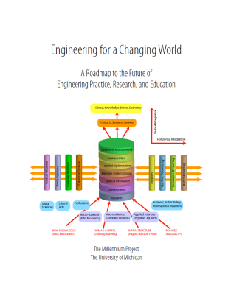
Engineering for a Changing World Duderstadt (2008)
Preeminence in technological innovation requires leadership in:
Engineering research
Engineering education
Engineering profession
In a global, knowledge-driven economy, our success or failure will be measured by how well or poorly we do with respect to the innovation agenda
Engineers are key players in the innovation ecosystem

Slide 4
The Canadian Innovation Challenge

Slide 5
What is Innovation?
“Innovation is new or better ways of doing valued things. Innovation is not limited to products but includes improved processes like the assembly line, and new business models like web-based commerce. An “invention” is not an innovation until it has been implemented to a meaningful extent.” (Council of Canadian Academies, 2009)
Innovation is the process by which individuals, companies and organizations develop, master and use new products, designs, processes and business methods. … The components of innovation include research and development, invention, capital investment and training and development. (STIC, 2008)
Innovations can be ‘transformative’ and result in the development of entirely new markets or they can be incremental.

Slide 6
Why is Innovation Important?
Innovation → Productivity → Income → Higher Standard of Living
“Innovation drives an economy’s ability to create more economic value from an hour of work. The resulting productivity growth creates potential for rising wages and incomes, and thus for a higher standard of living.” (Council of Canadian Academies, 2009)
To date we have been fortunate to benefit from a dominant natural resources economy … but that is not the answer!
In fact, we have failed to innovate in that sector, e.g., pulp and paper industry
We have also been fortunate to rub shoulders with the up to now, dominant world economy – but for how long?

Slide 7
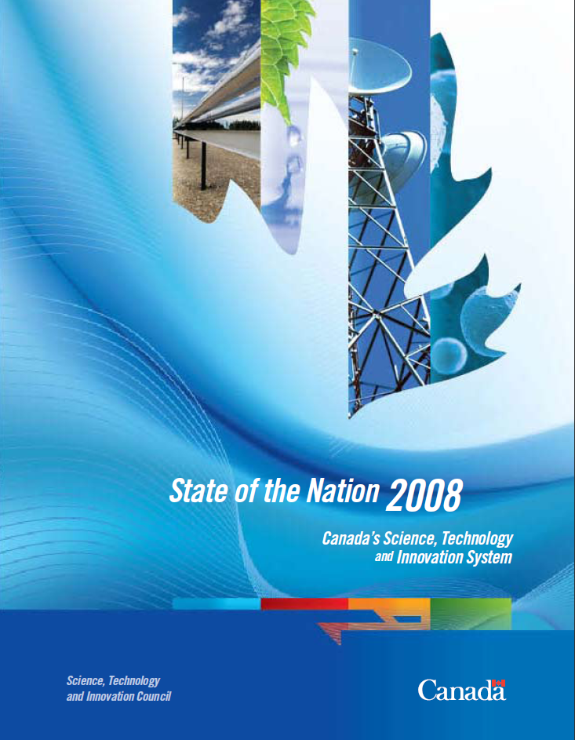
Canada and the Canadian Innovation Eco-System
April 2008
June 2008
Nov. 2009
Nov. 2008

Slide 8
The Drivers of Innovation
Some of the drivers of innovation include:
a private sector that has science, technology, and innovation strategies at its core;
institutions of education and research that develop, recruit, and retain strong talent pools; and
researchers who keep us at the forefront of knowledge and workers who see and act on opportunities to work smarter and more creatively

Slide 9
Canadian Firms Must Innovate (Craig Alexander, TD chief economist)
“One only need to observe the number of engineers graduating every year in Asia for a sign of things to come. The bottom line is that Canadian firms must innovate or perish.”
“From the Second World War to the early 1970s, productivity grew at more than 4% a year. But from the 1970s until 2000 it grew at only 1.6%, and in the past decade it slipped to a “shockingly low” 0.7%. “

Slide 10
Gross Expenditures on Research and Development (GERD)
“As a percentage of GDP, GERD was 1.97% in 2006, continuing a downward trend from 2.09% in 2001.
It is increasingly important for Canada to be competitive with other countries that are aggressively increasing their GERD, such as Finland and Japan, both of which by 2002 exceeded 3% GERD as a percentage of GDP, following steady increases since the early 1990s.”

Slide 11
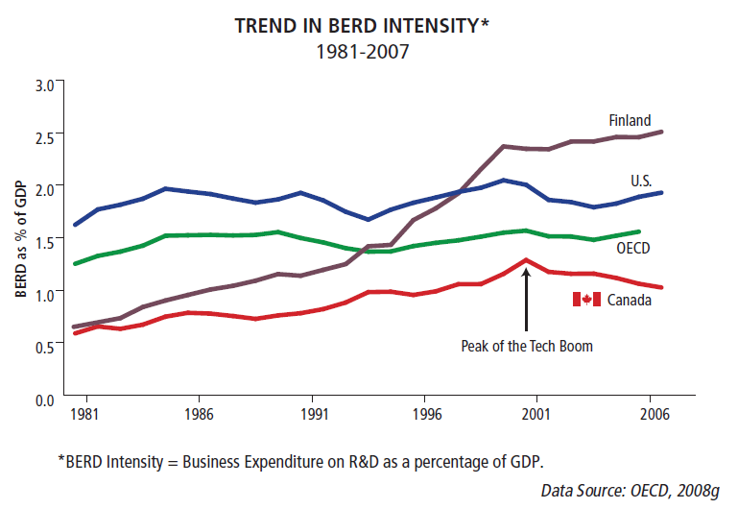
Business Expenditures in R&D

Slide 12
Trends in R&D Intensity in Canada 1981-2007
Post Nortel
Debacle ?

Slide 13
The Canadian Innovation Gap
We rank poorly across almost all aspects of innovation:
the creation of knowledge,
the diffusion of knowledge,
the transformation of knowledge and
the use of knowledge through commercialization. (Compete to Win, 2008)
While Canada has the highest rate of college completion among its peer group, Canada produces
few graduates with advanced degrees (masters and PhD) in science and engineering; and
few graduates in business (Conference Board of Canada, 2008)
few domestic students interested in graduate engineering studies

Slide 14
Number of PhD graduates per 100,000 population aged 25 to 29
Source : Conference Board
http://www.conferenceboard.ca/HCP/Details/education/Phd-graduates.aspx#context

Slide 15
New Graduates in 2007
Source: AUCC (H. O'Heron) & Stats Canada)

Slide 16
Engineering for a Changing World 2008
James Duderstadt
President Emeritus and Past Dean of Engineering
The University of Michigan
The emergence of a global, knowledge driven economy based upon technological innovation … is likely to demand (demands) a profound transformation of engineering practice, research and education.
Engineering practice and the technology needs are changing the nature of engineering practice demanding far broader skills than the simply mastering scientific and technological disciplines

Slide 17
The facts …
Off-shoring of engineering jobs
The decline of student interest in science and engineering
The decline in the participation of women in engineering
The decline in the number of domestic students in graduate studies in engineering
The lack of visibility of the profession (e.g., law and MD)
The virtual absence of engineers in the public policy debates
Raises serious questions about the adequacy of our approach to engineering – the profession and education

Slide 18
Leadership in the Engineering Profession

Slide 19
Leadership in the Engineering Profession
However …
It has been said that engineering in this country is an invisible profession. This is mainly because most Canadians have only a vague and limited idea of what we do. As a result, our national consciousness is not aware of the role engineers play in medical research advances; in alleviating human suffering; in creating devices such as the Blackberry or the iPod.

Slide 20
Some have argued that Engineering is becoming a 2nd Tier Profession?
MD … LLB … PEng Why is it that we rarely quibble when a lawyer bills us $500+/h by 6 min increments and achieves more than 2000 h per year of effective billing, while a senior engineering consultant will have to negotiate down his hourly rate to below $150/h?
“Engineers in the early days of the space race used to tell the story that when a rocket launched successfully, it was called a scientific breakthrough. But if it exploded on the pad or shortly thereafter, it was called an engineering failure.” Stephen J. Mraz http://machinedesign.com/article/changes-in-the-engineering-profession-over-80-years-0407

Slide 21
Engineers and Public Policy
Why is it that engineers are virtually absent from key public policy decisions involving many scientific and engineering issues, e.g.,
Energy
Telecommunications
Health
Environment
Water

Slide 22
An Example: Water Governance
An excellent book on water governance in Canada (2007)
27 contributors addressing issues such as:
Water supply
Water quality
Water commerce
Watershed management
Wastewater treatment
Water rights
NOT a single engineer
Let’s face it … If we do not get involve in the debates, in the shaping of public policies … we risk that they will be set by individuals that are not fully informed !

Slide 23
Engineers and Public Policy
The engagement of engineers in shaping public policies has been virtually non-existent.
We should not be surprised - as engineers have never been trained to address, participate or understand such issues
It is critical that engineers get involve in the development of public policies, to ensure that public policies are based on sound engineering and scientific concepts. At the same time this will allow us to translate complex engineering concepts into a publicly accessible discourse.

Slide 24
Duderstadt (2008) on the Status of the Profession
“It is essential to elevate the status of the engineering profession, providing it with the prestige and influence to play the role it must in an increasing technology-driven world while creating sufficiently flexible and satisfying career paths to attract a diverse population of outstanding students. Of particular interest is greatly enhancing the role of engineers both in influencing policy and popular perceptions and as participants in leadership roles in government and business.”

Slide 25
There is hope …
These observations should not be surprising:
Public policy issues have traditionally been addressed by the faculties of social sciences
Engineers were not trained on the importance of taking part in the public policy debate
There’s hope …
The creation in 2006 of the Graduate School of Engineering Practice at McMaster and the Dofasco Centre for Engineering and Public Policy; and
The launch in 2008 of the PEO Centre on Engineering and Public Policy.
Leadership in the Engineering Profession requires Leadership in Education

Slide 26
Leadership in Engineering Education

Slide 27
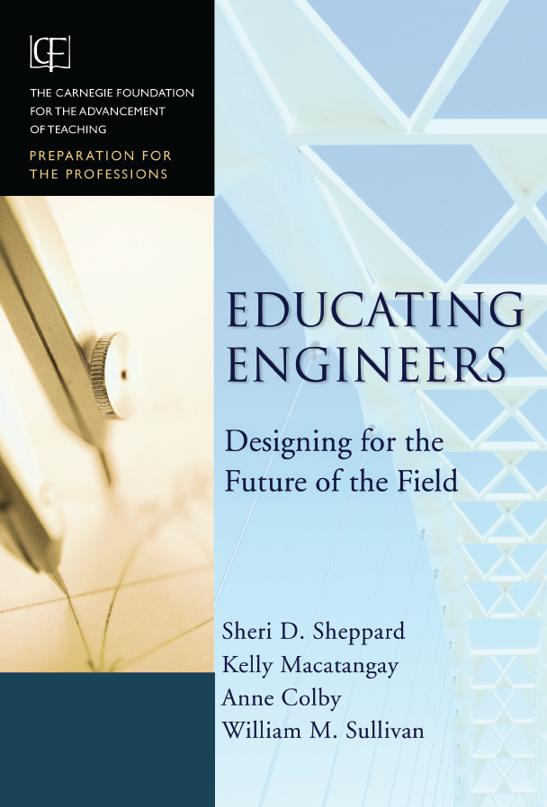
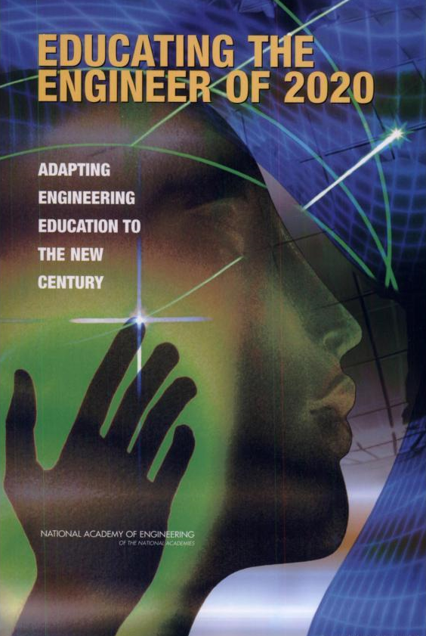
Leadership in Engineering Education
2008
2004
2008
2005
2009
2009

Slide 28
Educating Engineers (2009)
Part of the CF Preparation for the Professions Project
Looking at the education of doctors, engineers, lawyers, nurses, clergy, and teaching.
Characteristics of the Professions:
Service to others
Theoretical body of knowledge
Domain of practice
Judgment
Experience
Professional community
Multidisciplinary-overlapping teams.
Dr. Sheppard presents her report:
http://video.google.com/videoplay?docid=7410299255750354637#

Slide 29
Carnegie Foundation – Educating Engineers
“Although engineering education is strong on imparting some kinds of knowledge, it is not very effective in preparing students to integrate their knowledge, skills, and identity as developing professionals”

Slide 30
Carnegie Foundation – Educating Engineers
Aligning Engineering Education to Engineering Practice
Engineering should be taught as a profession – not as a collection of technical knowledge
Imperative for teaching for professional practice

Slide 31
Engineering for a Changing World 2008
Duderstadt provides a comprehensive analysis of Engineering Education, Research and Practice.
Important to broaden the educational experience of engineering students.
Engineers will require a much higher level of education in professional skills such as innovation, entrepreneurship and global engineering practice.
Establish engineering practice as a true learned profession
U/G engineering should be configured as an academic discipline similar to other liberal arts disciplines to provide students with more flexibility in their learning experience.
Establish graduate professional schools of engineering that offer practice-based degrees at the post-baccalaureate level as the entry degree in the profession.

Slide 32
A Multidisciplinary Liberal Arts Approach
There is a strong consensus that engineers of the 21st century must be broad thinkers who appreciate the global and societal implications of engineering and value the critical links between technology and society.
In 2001, the 2020 Engineering Forum held in Ontario concluded that engineers had to acquire skills leading to “social, global and political awareness” and to “ethical decision making”. It called for a more flexible definition of engineering by promoting interdisciplinarity, a better balance between “technical and artistic training” and more emphasis on teamwork and communication skills.

Slide 33
Leadership in Engineering Education
If we are to take a leadership role in engineering education we need to support and value teaching … after all … that’s what it’s all about !
Universities should take a leadership role in working together to develop state-of-the-art multi-media (self-paced) pedagogical material

Slide 34
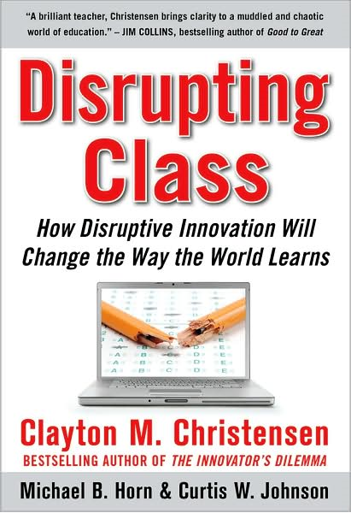
Leadership in Engineering Education and Technology
We are still in the “middle ages” when it comes to the use of technology in engineering education – the technology and the tools are there, the will is not!
Technology-based learning could be easily be used to address the different learning approaches advocated by Clayton Christensen

Slide 35
Structure of the Engineering Program
Should Engineering be a 2nd–entry program much like medicine and law?
This was the case in Quebec until 1966. Before the introduction of the CEGEPs, all students would do a B.A. (the collège classique) prior to admission at École Polytechnique
Alternatively, we could consider moving to a 5 or 6-year program, i.e., 2 or 3 years of arts/science followed by 3 years of engineering)

Slide 36
Attracting More Women in Engineering
Incorporating these changes will enable engineering education to respond to another key challenge: the continuing under-representation of women in engineering. Universities in Canada and abroad, still face the continuing under-representation of women in engineering studies. In fact, since 2001, female participation in undergraduate engineering in Canada has fallen from 23 to just 17%.

Slide 37
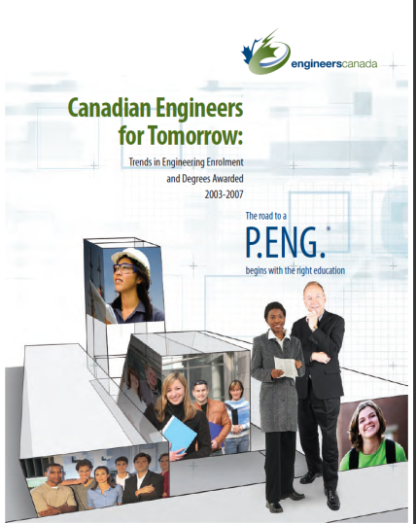
Undergraduate Enrolment by Gender
“Canadian Engineers for Tomorrow: Trends in Engineering Enrolment and Degrees Awarded 2004-2008” (2009)
“This flattening in enrolment of women presents another question
mark in a puzzling trend; the proportion of female engineering
students rose for a full 10 years, to a peak of 20.7 percent in 2001,
and then began to decline.”
Notes:
Attracting more women in engineering education
Incorporating these changes will enable engineering education to respond to another key challenge: the continuing under-representation of women in engineering. McMaster, like other universities in Canada and abroad, still faces the continuing under-representation of women in engineering studies. In fact, since 2001, female participation in undergraduate engineering in Canada has fallen from 23 to just 17%.
Several factors can explain this decline, including an overly rigid and heavily prescriptive curriculum, the enduring image of engineering as a “male-dominated” profession and women’s attraction to the life sciences. However, there is ample evidence that a more creative and socially relevant curriculum tends to bring and retain more women into engineering studies. Their stronger presence in fields such environmental engineering and biomedical engineering confirms that women tend to internalize engineering as a helping profession.
In 2006, National Engineering Week celebrated engineering as “a caring profession”. Canadian engineers need to impress more on the public this key dimension of our profession.

Slide 38
Women in Engineering
Several factors can explain this decline, including an overly rigid and heavily prescriptive curriculum, the enduring image of engineering as a “male-dominated” profession and women’s attraction to the life sciences.
However, there is ample evidence that a more creative and socially relevant curriculum tends to bring and retain more women into engineering studies.
Their stronger presence in fields such environmental engineering and biomedical engineering confirms that women tend to internalize engineering as a helping profession.

Slide 39
Conclusions
Leadership in Innovation:
Need to address the shortfall in GERD … but it’s not just about spending more money, it’s about spending it more effectively
Need to address the imbalance in BERD, HERD and GovERG and encouraging businesses to value and invest in R&D
Need to address the shortfall in the training of graduates particularly at the PhD level and courage more Canadians to consider graduate studies in engineering and science
Need to develop a culture of innovation and entrepreneurship early

Slide 40
Conclusions
Leadership in Engineering Education
There is a need to incorporate a strong liberal arts component in engineering education
2nd-entry approach (e.g., law and medicine)
2+3 or 3+3 model
A focus on “global” education – addressing such issues as innovation, entrepreneurship, communication, culture, arts, science
A curriculum centered on the profession of engineering

Slide 41
Conclusions
Leadership in the Engineering Profession
Engineers need to take on leadership roles
Engineers need to help shape public policies
If we want to cast away this “cloak of invisibility”, we need to get the word out about the work engineers do, so that Canadians fully recognize the benefits they provide for our society.

Slide 42
Conclusions
Increasingly, employers are looking for engineers who are … what they call …. “Entrepreneurial integrators”. That is, creative people who bring together pieces of various disciplines to make things happen.
Innovation in this country depends on our effectiveness to address these challenges

Slide 43
Thank you!

